Slide 1
Running GenAI on Intel AI Laptops and Simple LLM Inference on CPU and fine-tuning of LLM Models using Intel® OpenVINO™
as part of Intel Unnati Industrial Training Program 2024 by Team ATOM

Slide 2
Problem Statement
Running GenAI on Intel AI Laptops and Simple LLM Inference on CPU and fine-tuning of LLM Models using Intel® OpenVINO™

Slide 3
Unique Idea Brief
The solution involves:
- Using Intel AI Laptops to run General AI (GenAI) applications efficiently.
- Implementing simple LLM (Large Language Model) inference on CPUs to leverage their processing power.
- Fine-tuning LLM models using Intel® OpenVINO™ to enhance performance and reduce inference times.
- Comparing the performance of fine-tuned models against standard models to demonstrate improvements in speed without significant loss in accuracy.

Slide 4
Features Offered
- Efficient execution of GenAI applications on Intel AI Laptops.
- Faster LLM inference times on CPU.
- Enhanced model performance through fine-tuning with Intel® OpenVINO™.
- Compatibility with various language models and configurations.

Slide 5
Process Flow
1. Model Configuration: Define the model to be used and its parameters.
2. Quantization and Fine-Tuning: Convert and fine-tune the model using Intel® OpenVINO™.
3. Testing: Evaluate the performance of both the fine-tuned and standard models.
4. Comparison: Visualize the performance differences through metrics such as inference time.

Slide 6
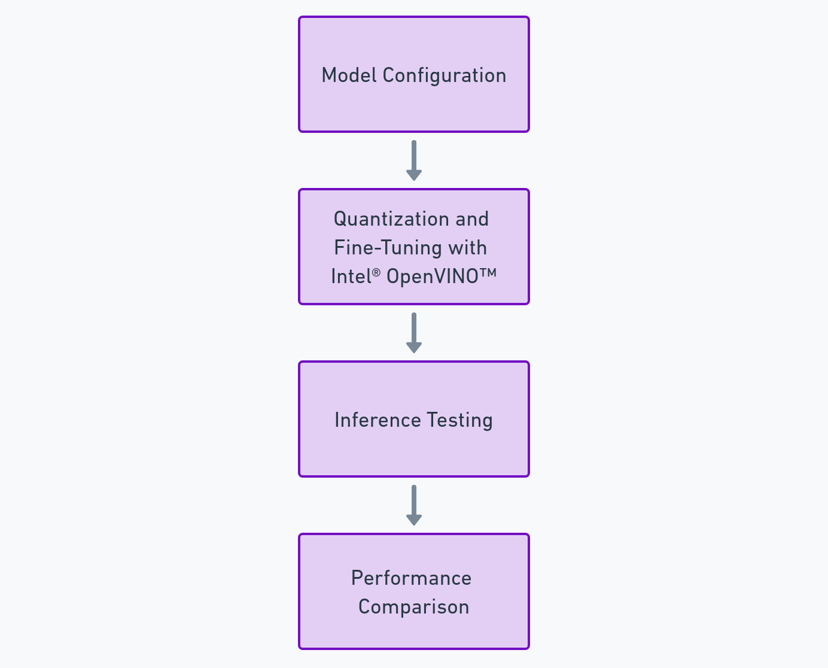
Architecture Diagram

Slide 7
Technologies Used
- Python
- Intel AI Laptops
- Intel® OpenVINO™
- PyTorch (for handling the language models)
- Matplotlib (for plotting performance comparison)

Slide 8
Team Members and Contribution
- Roen Vishal Rao: Model configuration and quantization.
- Ajmal Aksar: Performance testing and comparison.
- Winston James Daniel B: Performance testing and comparison.
- Gideon Suttle: Visualization and documentation.
- Melvin Babu T: Visualization and documentation.

